Slide 1

GTAW

Slide 2
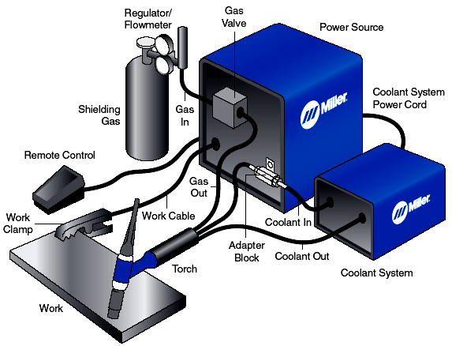

Slide 3
The GTAW (TIG) Process
The necessary heat for Gas Tungsten Arc Welding (TIG) is produced by an electric arc maintained between a no consumable tungsten electrode and the part to be welded.
The heat-affected zone, the molten metal, and the tungsten electrode are all shielded from the atmosphere by a blanket of inert gas fed through the GTAW torch. Inert gas is that which is inactive, or deficient in active chemical properties. The shielding gas serves to blanket the weld and exclude the active properties in the surrounding air. It does not burn, and adds nothing to or takes anything from the metal.

Slide 4
Inert gases such as argon and helium do not chemically react or combine with other gases. They possess no odor and are transparent, permitting the welder maximum visibility of the arc. In some instances a small amount of reactive gas such as hydrogen can be added to enhance travel speeds.
The GTAW process can produce temperatures of up to 19,426° C. The torch contributes only heat to the workpiece. If filler metal is required to make the weld, it may be added manually in the same manner as it is added in the oxyacetylene welding process. There are also a number of filler metal feeding systems available to accomplish the task automatically. Figure shows the essentials of the manual GTAW process.

Slide 5
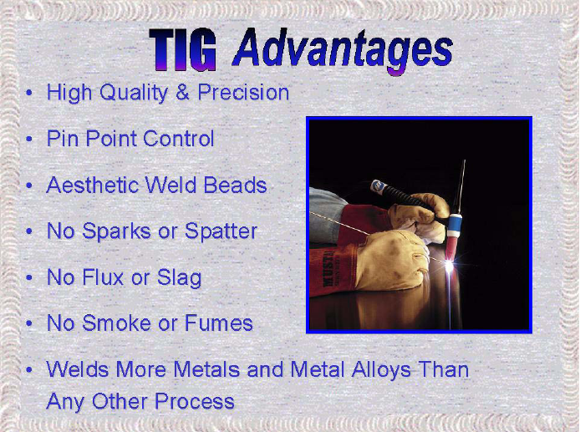

Slide 6
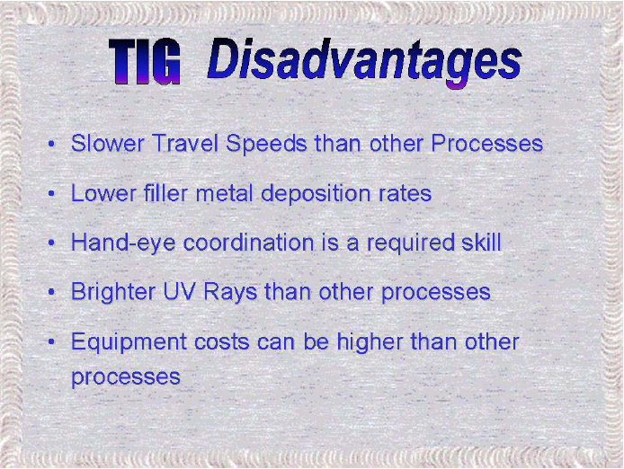

Slide 7
Process Summary
GTAW is a clean process. It is desirable from an operator point of view because of the reasons outlined. The welder must maintain good welding conditions by properly cleaning material, using clean filler metal and clean welding gloves, and by keeping oil, dirt and other contaminants away from the weld area. Cleanliness cannot be overemphasized, particularly on aluminum and magnesium. These metals are more susceptible to contaminants than are ferrous metals. Porosity in aluminum welds has been shown to be caused by hydrogen. Consequently, it is most important to eliminate all sources of hydrogen contamination such as moisture and hydrocarbons in the form of oils and paint.

Slide 8
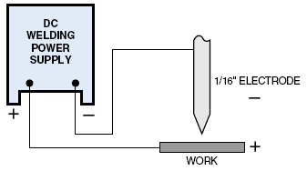
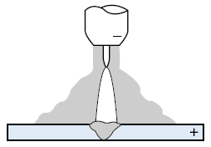
Direct current electrode negative
GTAW with DCEN produces deep penetration because it concentrates the heat in the joint area. No cleaning action occurs with this polarity. The heat generated by the arc using this polarity occurs in the workpiece, thus a smaller electrode can be used as well as a smaller gas cup and reduced gas flow. The more concentrated arc allows for faster travel speeds.

Slide 9
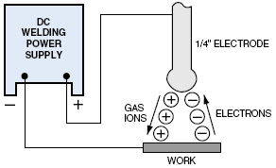
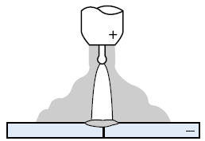
Direct Current Electrode Positive
GTAW with DCEP produces good cleaning action as the argon gas ions flowing toward the work strike with sufficient force to break up oxides on the surface. Since the electrons flowing toward the electrode cause a heating effect at the electrode, weld penetration is shallow. Because of the lack of penetration and the required use of very large tungsten, continuous use of this polarity is rarely used for GTAW.

Slide 10
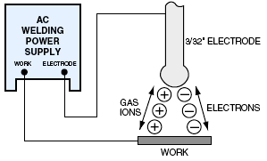
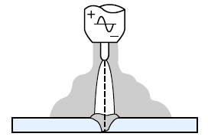
Nature of current on weld bead
GTAW with AC combines the good weld penetration of DCEN with the desired cleaning action of DCEP. With certain types of AC waveforms high frequency helps re-establish the arc, which breaks each half cycle. Medium size tungsten are generally used with this process.

Slide 11
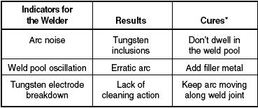
Arc Rectification

Slide 12
Controlling the Advanced Square wave Power Source

Slide 13
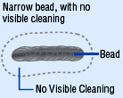
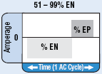
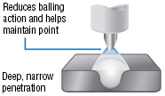
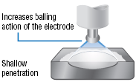
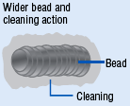
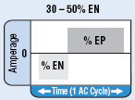
Feature | Waveform | Effect on Bead | Effect on Appearance
AC Balance Control Controls arc cleaning action. Adjusting the % EN of the AC wave controls the width of the etching zone surrounding the weld.

Slide 14
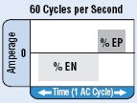
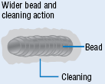
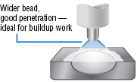
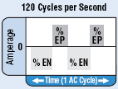
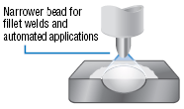
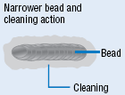
Feature | Waveform | Effect on Bead | Effect on Appearance
AC Frequency Control Controls the width of the arc cone. Increasing the AC Frequency provides a more focused arc with increased directional control

Slide 15

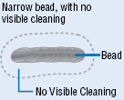
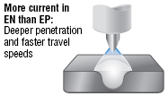
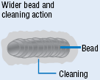

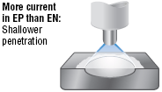
Feature | Waveform | Effect on Bead | Effect on Appearance
Independent AC Amperage Control Allows the EN and EP amperage values to be set independently. Adjusts the ratio of EN to EP to precisely control heat input to the Work and the electrode.

Slide 16
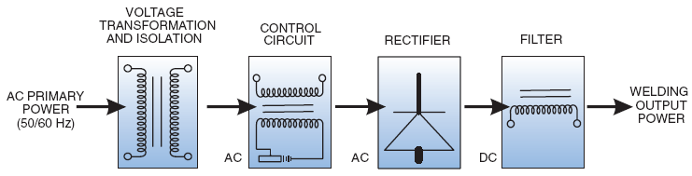
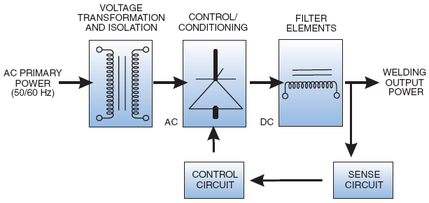
A conventional line frequency power source block diagram
The closed loop feedback keeps the output consistent when the arc voltage
is varied and to compensate for primary line voltage fluctuations

Slide 17
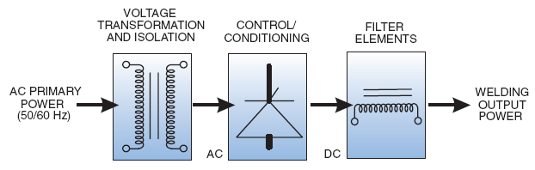
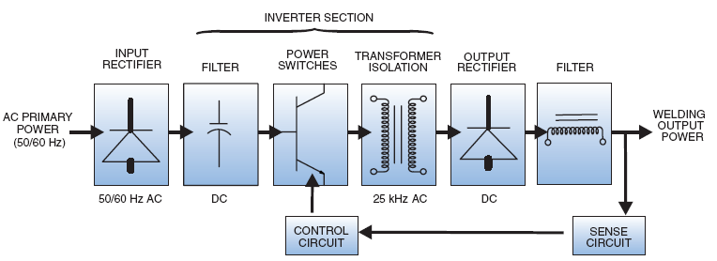
Block diagram of an SCR controlled power source,
utilizes a line frequency weld transformer
An inverter power source block diagram

Slide 18
SHIELDING GASSES

Slide 19
Argon
.
Argon has low thermal conductivity which means it is not a good conductor of heat. This results in a more compact, higher density arc. Arc density refers to the concentration of energy in the arc. With argon this energy is confined to a narrow or more “pinpointed” area. Argon provides excellent arc stability and cleaning action even at low amperages

Slide 20
HELIUM
Unlike argon, helium has high thermal conductivity. Due to this higher thermal conductivity, the arc column expands, reducing current density in the arc. The arc column will become wider and more flared out than the arc column with argon shielding gas. Because of its higher ionization potential, it is more difficult to start an arc with helium shielding gas, especially at lower
amperages. Argon is used almost exclusively when welding at 150 amps and lower. Because helium is a light gas, flow rates are usually two or three times higher than argon for equivalent shielding. The cost of helium is considerably more than argon, and with the increased flow rate, total cost of shielding goes up sharply. The cost must be weighed against increased penetration on thick material and the increased travel speed attainable.

Slide 21
Hydrogen
Just as helium is mixed with argon to take advantage of the best features of both gases, hydrogen is mixed with argon to further constrict the arc and produce a cleaner weld with a greater depth to width ratio (penetration). This mix is used primarily for Welding austenitic stainless steel and some nickel alloys. The addition of hydrogen to argon also increases travel speed. It should be noted that an argon hydrogen mix will introduce the risk of hydrogen cracking and metal porosity particularly in multi-pass welds.

Slide 22
Nitrogen
Nitrogen when mixed with argon provides the capability of producing more energy to the work than with argon alone. This can be particularly beneficial when welding materials of high conductivity such as copper. However, a nitrogen mix cannot be used on ferrous metals such as steel and stainless steel because nitrogen pick up in the weld pool causes a Significant reduction in strength and a weaker, more porous bead.

Slide 23
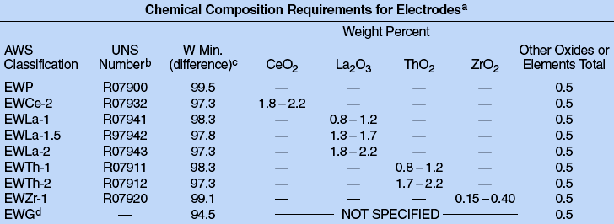
Electrodes and Consumables

Slide 24
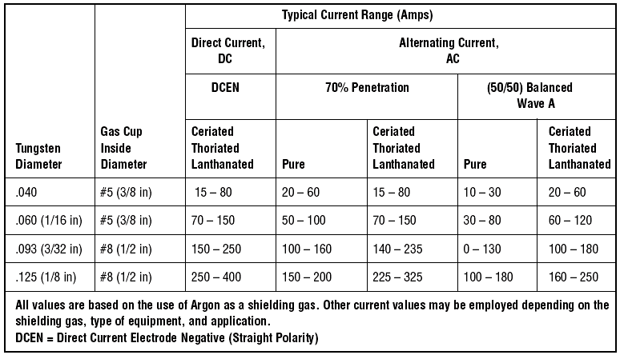
Typical current ranges for electrodes with argon shielding

Slide 25
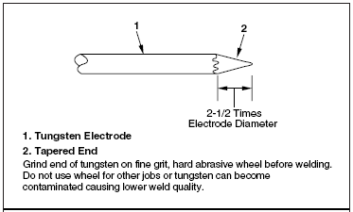
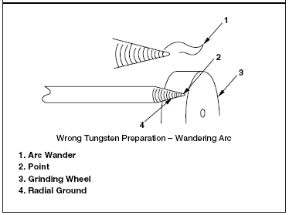
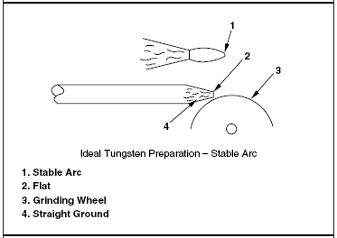
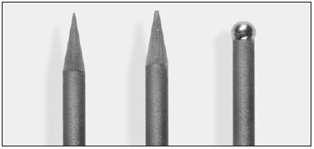
Preparing tungsten for DC electrode negative welding and AC with wave shaping power sources
The ball diameter should never exceed
1.5 times the electrode diameter

Slide 26
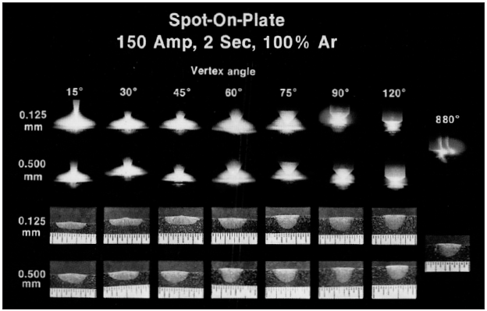
Arc shape and weld profile as a function of electrode tip angle

Slide 27




 | This pure tungsten was used with alternating current with a sine Wave power source on aluminum. Notice the end is uniform in shape and possesses a “shiny bright” appearance
 | is a 2% Thoriated tungsten ground to a taper and was used with direct current electrode negative, or a similar shape for Advanced Square wave applications
 | is a 2% Thoriated tungsten used with an alternating current sine wave power source on aluminum. Note that this electrode has several small ball shaped projections rather than a round complete “ball end” like the pure tungsten
 | is a pure tungsten used with alternating current sine wave power source or balance control set to excessive cleaning action on an AC wave controlled power source on aluminum. This electrode was subjected to a current above the rated capacity. Notice the “ball” started to droop to one side. It became very molten during operation and continuing to operate would have caused the molten end to drop into the weld pool

Slide 28



 | is a pure tungsten that was tapered to a point and used on direct current electrode negative. Notice the “ball” tip characteristic of the pure tungsten. Pointing of pure tungsten is not recommended as the extreme point will always melt when the arc is established, and often times the molten tip will drop into the molten weld pool
 | was severely contaminated by touching the filler rod to the tungsten. In this case, the contaminated area must be broken off and the electrode reshaped as desired
 | did not have sufficient gas post flow. Notice the black surface which is oxidized because the atmosphere contacted the electrode before it cooled sufficiently. If this electrode were used, the oxidized surface will flake off and drop into the weld pool. Post flow time should be increased so the appearance is like electrode “A” after welding

Slide 29
Preparing Mild Steel for Welding

Slide 30
Mild steel should always be mechanically cleaned prior to welding. Rust, paint, oil and grease, or any surface contaminants should be removed. Hot-rolled products such as angle iron, plate, and pipe may contain a heavy mill scale. For best results, remove scale prior to welding. Black pipe usually contains a varnish type coating, which should be removed before welding

Slide 31
Welding Mild Steel
Low carbon steels, commonly referred to as mild steels, are
readily welded by the GTAW process. These groups of steels
are available in many different alloys and types. The familiar
structural shapes, plates, and hot rolled sheet metal are
usually comprised of what is termed “semi-killed steel”. This
term means the steel has been partially deoxidized during
manufacture. The steel, however, still contains some oxygen,
and this oxygen can cause problems when welding. These
problems will appear in the form of bubbles in the weld pool,
and possibly in the finished weld bead. “Killed steel” has had
more oxygen removed in its manufacture, and presents less
of a problem when welding.

Slide 32
A filler wire containing sufficient silicon and manganese,
added as deoxidizers, is necessary. Lower grade filler rods
used for oxyacetylene welding of many hot rolled products
are not suitable for making high-quality GTAW welds.
Direct current electrode negative is recommended with
high-frequency start. A 2% Thoriated tungsten with point
Or taper on the electrode should be used.

Slide 33
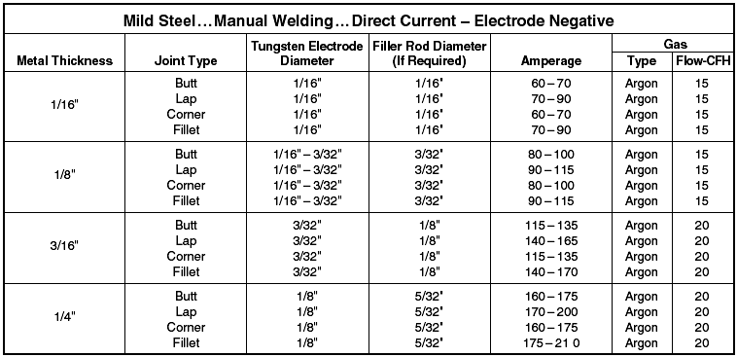
Mild steel weld parameters

Slide 34
GTAW Troubleshooting

Slide 35
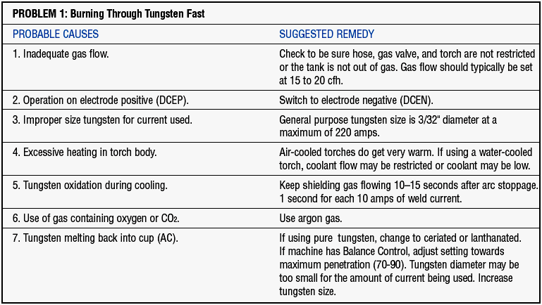

Slide 36
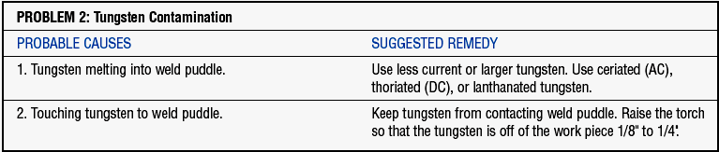
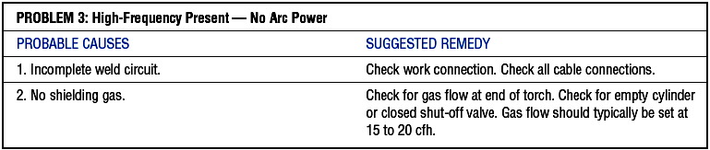

Slide 37
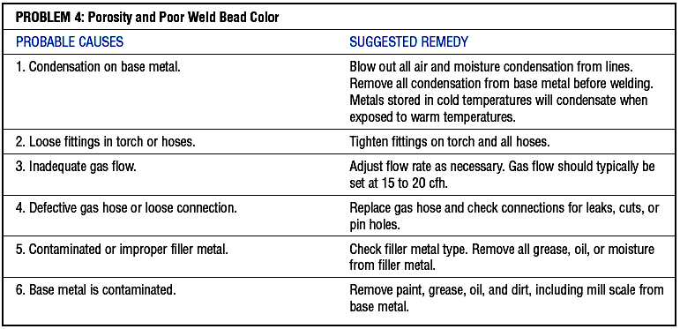

Slide 38
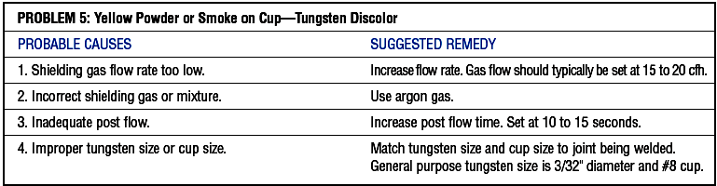
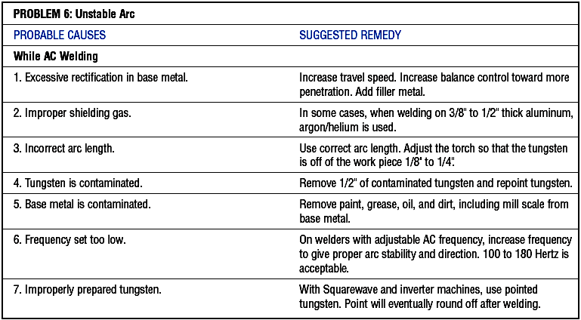

Slide 39
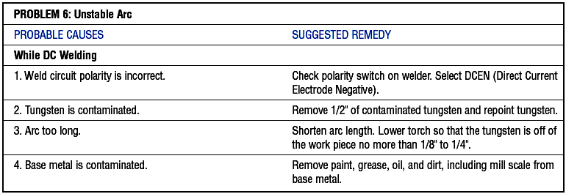

Slide 40
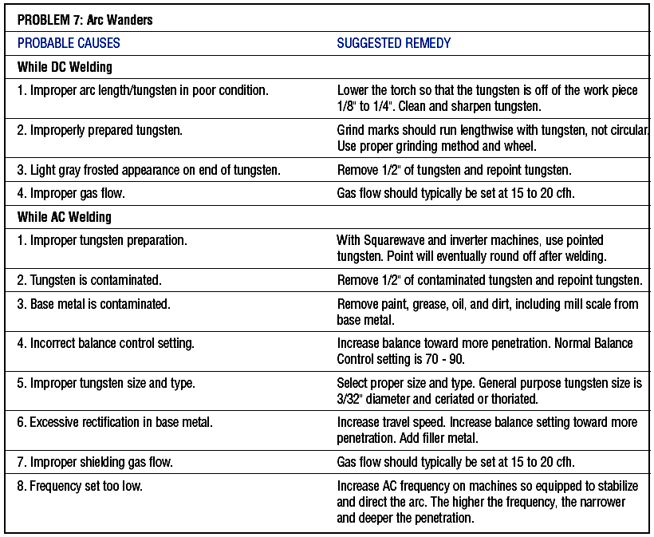

Slide 41
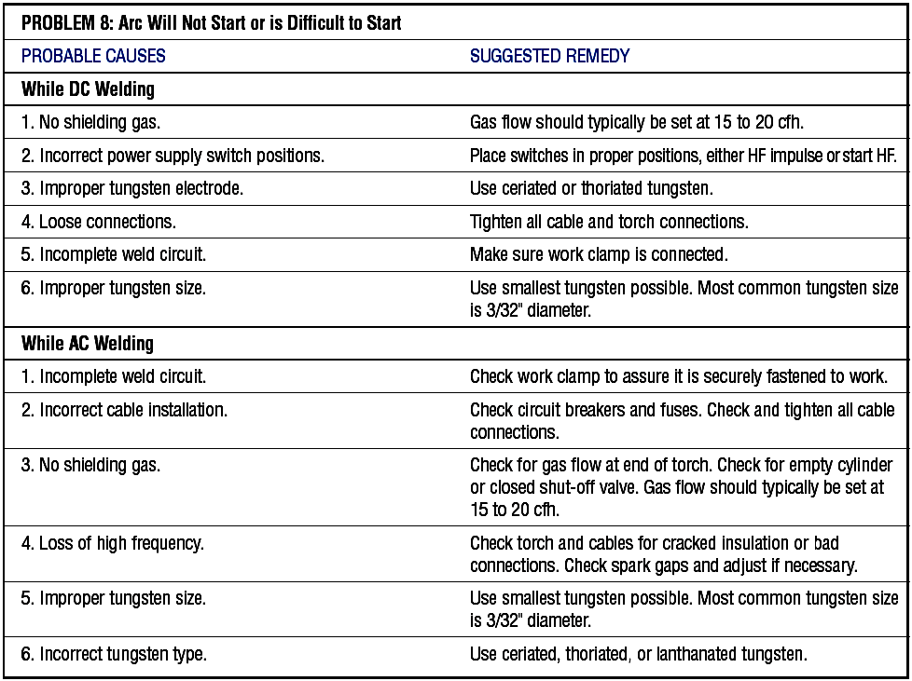

Slide 42
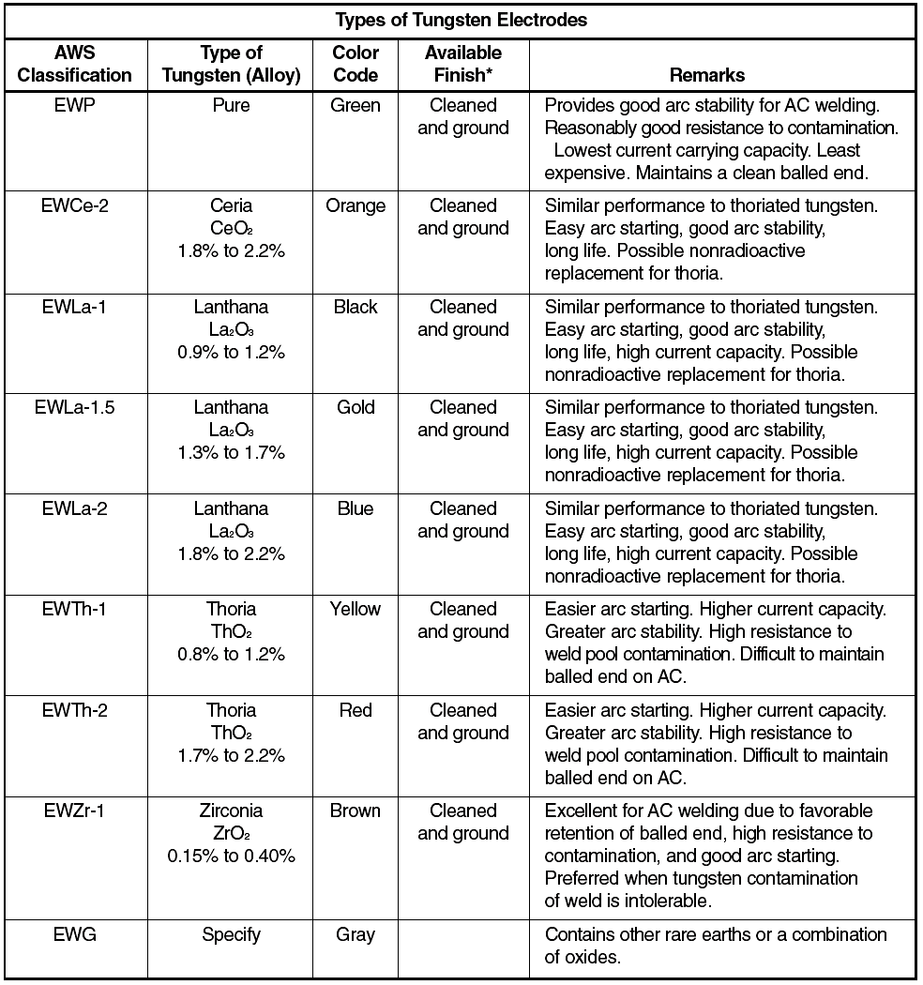
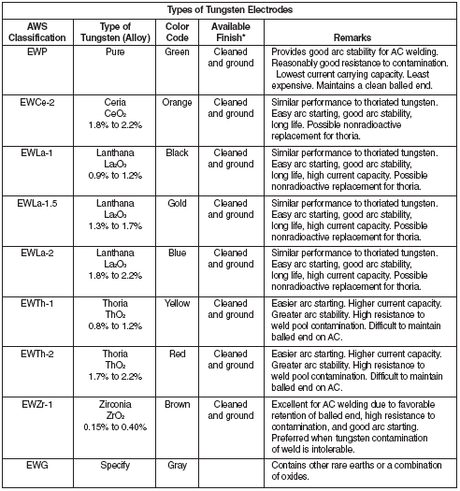

Slide 43
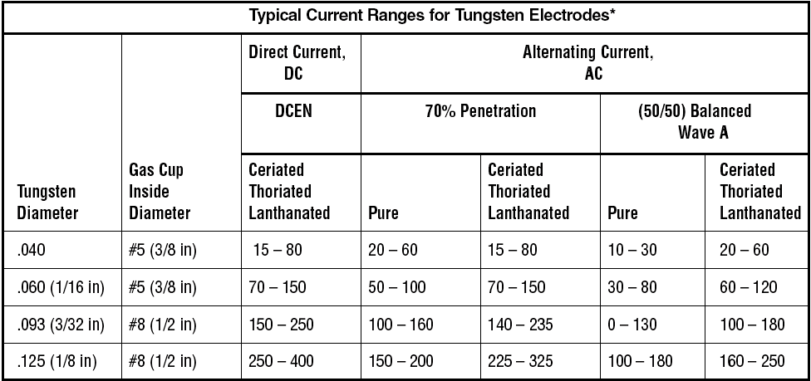

Slide 44
Recommended Types of Current, Tungsten Electrodes and Shielding Gases for Welding Different Metals
Types of Metal | Thickness | Type of Current | Electrode | Shielding Gas
Plain carbon low-alloy steels | All | DCEN | Lanthanide, cerium Thoriated | Argon or argon-helium
Stainless steel | All | DCEN | Lanthanide, cerium Thoriated | Argon or argon-helium

Slide 45



Slide 46


Slide 47


Slide 48
END

